Slide 1
MEKON/HOBO Introductory Tutorial
[Under Construction]

Slide 2
Primary Tutorial Goal
Introduction to modelling frameworks:
MEKON:
Models Embodying Knowledge from ONtologies
HOBO:
Hybrid models integrating OBjects and Ontologies
Covering:
General principles + concepts
Using actual MEKON/HOBO ClassNames
NOT covering:
Code-level examples

Slide 3
Secondary Tutorial Goal
Introduction to Model Explorer application
GUI-based tool for MEKON/HOBO developers
Covering:
Browsing of models
Exploration of dynamic behaviour of model-instantiations
Storage/retrieval/querying of model-instantiations
Note:
Model Explorer does NOT support any kind of model-editing

Slide 4
Tutorial Pre-Conditions
Basic familiarity with:
Frames-based knowledge representation
OWL + Description Logics
Accessed MEKON project website (*)
Viewed general introductory material
Checked-out all code and resources
Built all code and resources
Optionally via ANT build script provided
* https://code.google.com/p/mekon

Slide 5
Tutorial Format: General
Main Body:
Guides user through using Model Explorer to:
Browse simple demo model
Basic MEKON version
Hybrid HOBO/MEKON version
Create specific instantiations of demo model
Creating + storing “assertion” instantiations
Creating + executing “query” instantiations
Appendix:
Provides instructions on running Model Explorer with the different model-versions

Slide 6
Tutorial Format: Main Body
Actions:
A series of actions is described, to be performed via the Model Explorer (ME) application
The action descriptions come with screenshots showing either the actions being performed, or the results of the actions having occurred
Explanations:
Explanations are provide of the functionalities being displayed as the actions are performed
Interspersed throughout are general explanations, not specifically linked to the actions on any particular slides, but more generally applicable to various actions on previous and/or subsequent slides
Icons:
The semantics of the ME icons are summarised at the start of the tutorial (a similar glossary can also be obtained via the ME “Help” button)
Recaps are provided throughout for specific icons as they are introduced
The semantics of specific icon-modifiers are provided at relevant points

Slide 7
Browsing Basic MEKON Version of Model

Slide 8
MEKON Models
The MEKON frames model (FM) representation involves entities at three distinct representational levels:
Concept-Level : Representation of domain model
CFrame: Domain concept
CNumber: Numeric-value definition (numeric-type + valid value-range)
CValue: Concept-level value-entity (CFrame or CNumber)
CSlot: Inter-concept relationships OR numerical attribute of concept
Instance-Level: Representation of specific instantiations of domain model
IFrame: Instantiation of domain concept
INumber: Specific numeric value
IValue: Instance-level value-entity (IFrame or INumber)
ISlot: Inter-instance relationships OR numerical attribute value
Meta-Level: Representation of references to domain model entities
MFrame: Reference to domain concept (used solely for defining value-types of CFrame-valued slots)
Entity Sources:
All entities in a basic MEKON FM will be derived from one or more external knowledge sources (EKS), typically ontologies of some kind. However, when a HOBO object model (OM) is present, the source(s) for an FM entity can be external (EKS), internal (OM), or, where appropriate mappings have been provided in the configuration file, dual (EKS + OM).

Slide 9
Icon Summary
Shapes (all relevant colours)
Entity Category
Entity Level
Icon Shape
Value Entity (*)
Meta
Value Entity (*)
Concept
Value Entity (*)
Instance
Slot
Concept / Instance
* Frame OR Number
Colours (all relevant shapes)
Entity Category
Entity Source
Icon Colour(s)
Frame/Slot
External (OM)
Frame/Slot
Internal (EKS)
Frame/Slot
Dual (EKS + OM)
Number
ANY

Slide 10
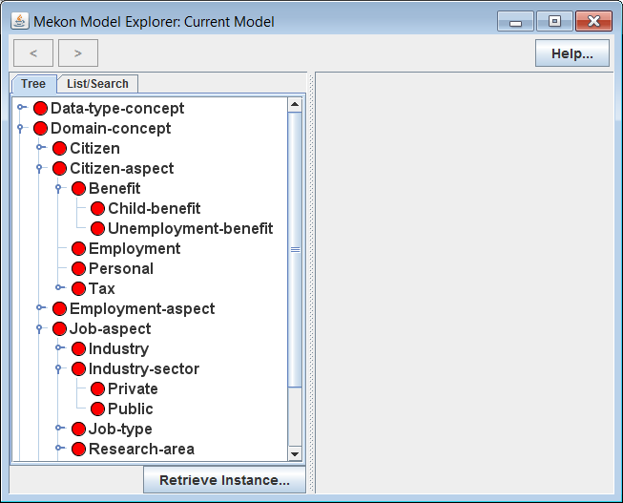
Reminder: See appendix at end of tutorial for Model Explorer invocation details
Actions:
Invoke ME with basic MEKON version of demo model
Open-up and explore tree in LH panel
Explanation:
Tree represents hierarchy of all concept-level frames, or CFrames, in model.
Model consists of this set of CFrames, together with associated sets of concept-level slots , or CSlots (not currently visible)
Icons Recap:
CFrame / external source

Slide 11
MEKON Model Building
Basic MEKON FMs are derived entirely from one or more EKSs. This contrasts with hybrid HOBO/ MEKON models, in which part of the FM is derived from a HOBO-based OM.
MEKON-OWL Model Builder Plug-in: In the case of the demo model, the basic version of the FM is built from an OWL ontology, by the standard plug-in. This plug-in uses some fairly obvious mappings, such as:
OWL class → CFrame
Existential property restriction → CSlot
Etc.
MEKON Configuration File: This file directs the entire model building process, specifying the relevant model-building plug-in(s), and any required reasoning plug-ins to be attached (such as the MEKON-OWL reasoning plug-in), and providing the required configuration information for each.
The same file is also used to specify the OM for HOBO/MEKON models, and any mappings between the OM and corresponding entities in the relevant EKSs.

Slide 12
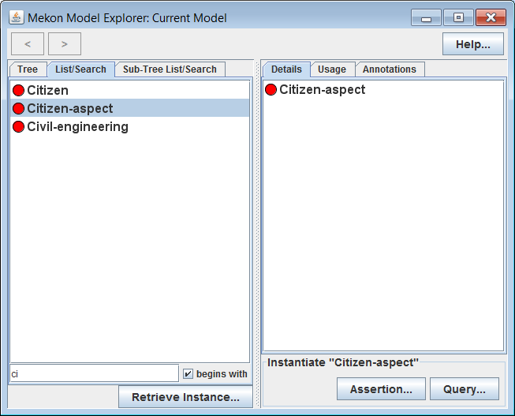
Actions:
Select various CFrames in LH panel, including some with sub-frames
Select “List Search” tab in LH panel
Filter resulting CFrames list by typing into text-box
Select specific CFrames from resulting lists
Explanation:
Details of selected CFrames appear in RH panel (to be explained in subsequent slides)
“Sub-Tree List Search” tab appears when any CFrame with descendants is selected, containing list consisting only of descendants of selected CFrame

Slide 13
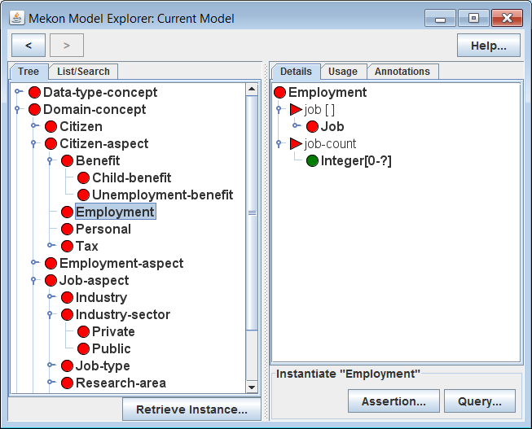
Actions:
Select “Employment” CFrame in LH panel (via any of the three tabs)
Explanation:
Details of “Employment” CFrame appear in RH panel, including details of two attached slots:
“job”: IFrame-valued slot (values must be instantiations of the “Job” CFrame)
“job-count”: Integer-valued slot (value-type is a CNumber, specifying valid INumber values)
Icons Recap:
CSlot / External source
CNumber / Source(s) as for parent-slot

Slide 14
Slot Specification
Value-Types: Each CSlot provides a value-type, which defines the valid values for the instantiating ISlots. Value-types are represented via entities from the level above that of the values that the ISlot will have:
Possible slot value-types are:
MFrame: Defines CFrame-valued ISlot
CFrame: Defines IFrame-valued ISlot
CNumber: Defines INumber-valued ISlot
Fixed Values: A CFrame can provide sets of “fixed-values” for instantiations of specific CSlots on either the CFrame itself or on any of it’s ancestors.
When the relevant CSlots are instantiated, along with the CFrame, any such values will be automatically added to the instantiating ISlots.
Note: Fixed-values can only be defined for CFrame-valued and INumber-valued slots. They are not applicable to IFrame-valued slots.
(See later slides in this section for examples of fixed-values.)

Slide 15
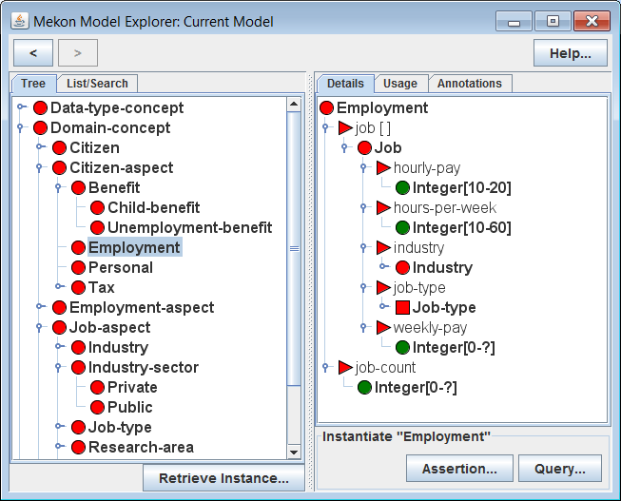
Actions:
Recursively expand section of tree under “Job” CFrame representing value-type of “job” slot in RH panel
Explanation:
Details of “Job”, along with all other CFrames representing slot value-types, are recursively displayed in RH panel
Displayed details include details of both slots and descendant CFrames
Value-type of “jobType” slot is a meta-level frame, or MFrame, rather than a CFrame. Hence the values for that slot will be CFrames rather than IFrames
Icons Recap:
MFrame / External source

Slide 16
Model Instantiations
A specific model-instantiation is represented via an appropriate IFrame/ ISlot network, with the IFrames and ISlots being instantiations of the relevant CFrames and CSlots.
Instantiation Initialisation: When a CFrame is instantiated as an IFrame, the IFrame is initialised as follows:
All CSlots on the CFrame, and on any ancestor CFrames, are instantiated as ISlots, and attached to the IFrame. Where there is more than one such CSlot for a particular property, then a single ISlot is created whose value-type is the intersection of the value-types of all contributing CSlots.
All fixed-values on the CFrame, and on any ancestor CFrames, are added to the ISlots.

Slide 17
Actions:
Navigate backwards and forwards through previous selections using “<“ and “>” arrows in top left of GUI
Select any CFrame in the RH panel to update selection in LH panel (and hence to update displayed details in RH panel)

Slide 18
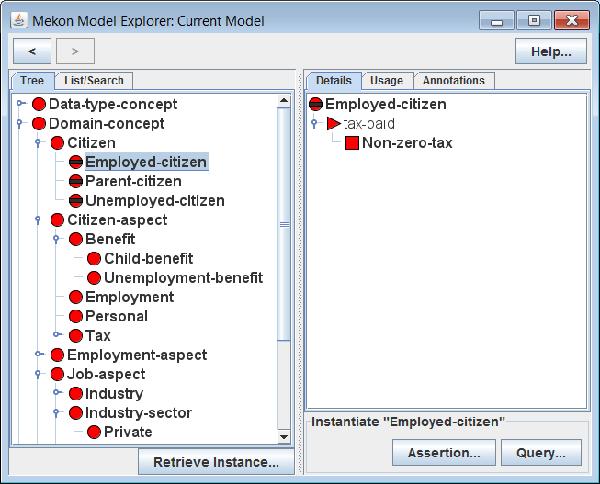
Actions:
Select “Employed-Citizen“ CFrame in LH panel
Explanation:
“Employed-Citizen” is a hidden CFrame, which means that it cannot be instantiated, though it can play a role in the automatic updating of instantiations
If an IFrame instantiating “Citizen” is inferred (*) to be an instance of “Employed-Citizen” , then the value-type of the “tax-paid” slot on that IFrame will be automatically updated, from the default value, “Tax”, as provided by “Citizen”, to the more specific “Non-zero-tax”, as provided by “Employed-Citizen”
* See next slide for further explanation of IFrame updating via OWL-based reasoning
Icon Modifier:
CFrame is hidden frame

Slide 19
Instantiation Updating
As the state of an instantiation (i.e. an IFrame/ ISlot network) is updated, additional updates may be automatically provided by appropriate reasoning plug-ins. In the case of the demo-model, this means the MEKON-OWL reasoning plug-in.
MEKON-OWL Reasoning Plug-in: Performs automatic instantiation updating as follows:
An OWL version of the IFrame/ISlot network is created: a class-expression if the network is a tree, a collection of individuals otherwise
The DL reasoner is invoked to find all inferred super-classes or inferred types of this OWL version
The corresponding CFrames are found, and the associated CSlots and fixed-values used to dynamically update the ISlots on the root IFrame of the instantiation

Slide 20
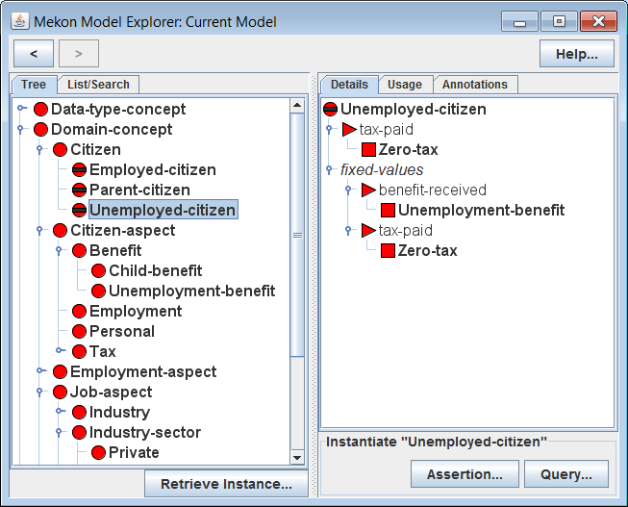
Actions:
Select Unemployed-Citizen CFrame in LH panel
Explanation:
“Unemployed-Citizen,” similarly to Employed-”Citizen”, provides a specialisation of the value-type for the “tax-paid” slot
It also provides fixed-values for both that slot and the “benefit-received” slot, representing actual values that will be assigned to the relevant ISlots whenever an IFrame is classified accordingly.
Hence if an IFrame instantiating “Citizen” is classified as an instance of “Unemployed-Citizen”, then not only will the “tax-paid” ISlot be given a specialised value-type of “Zero-tax”, it will also be assigned an actual value of “Zero-tax.” Similarly the “benefit-received” ISlot will be assigned a value of “Unemployment-Benefit”

Slide 21
Browsing Hybrid HOBO/MEKON Version of Model

Slide 22
HOBO/MEKON Hybrid Models
The HOBO framework provides the following:
Generic “modelling” classes and interfaces for building domain-specific OMs
Mechanisms for “binding” HOBO OMs to MEKON FMs
OM Modelling:
The main entities from which the domain-specific OMs are built are:
DObject: Interface implemented by all OM classes
DField: Class used to represent all OM fields (abstract base class with concrete extensions, DCell and DArray)
OM ←→ FM Bindings:
Every OM class or field will be “bound” to a corresponding FM entity (CFrame or CSlot respectively). The binding can be to either:
EKS-derived entity: If suitable mapping specified via HOBO configuration file
Specifically generated entity: Otherwise
The bindings ensure that any relevant operations initiated in either representation will be reflected by the occurrence of corresponding operations in the other.

Slide 23
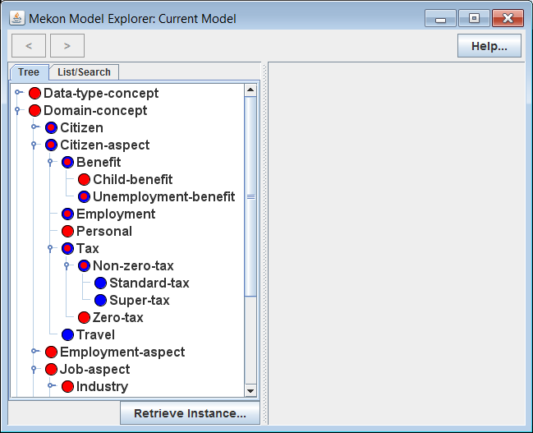
Reminder: See appendix at end of tutorial for Model Explorer invocation details
Actions:
Invoke ME with hybrid HOBO/MEKON version of demo model, whilst leaving running previous invocation of ME, with basic MEKON version of model, for comparison purposes
Open-up and explore CFrame tree in LH panel
Explanation:
The blue splurges now visible indicate that certain “key” CFrames are bound to OM classes
Some, such as “Citizen”, have dual sources – i.e. OM class and OWL class
Others, such as “Super-Tax”, have only an internal source - i.e. an OM class
Other CFrames , such as “Zero-Tax”, have only external sources, meaning that they are not represented at all in the OM
Note that those CFrames with external or dual sources also appear in the basic MEKON version of the model, whereas those with only internal sources do not
Icons Recap:
CFrame / Internal source
CFrame / Dual sources

Slide 24
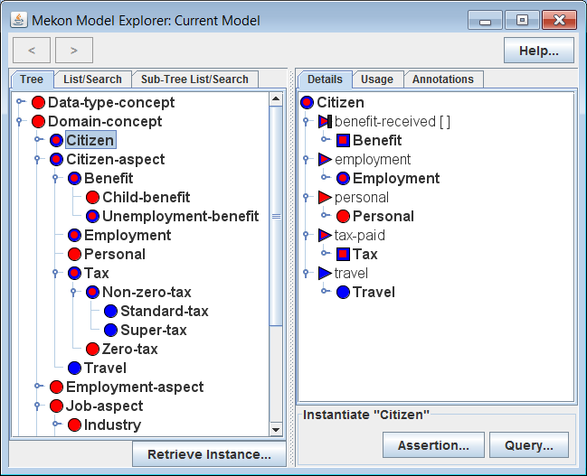
Actions:
Select “Citizen” CFrame in LH panel
Explanation:
The CSlots that appear, along with their value-types, are similarly indicated as having either internal, external or dual sources.
The “benefit-received” CSlot has been specified (by the OM in this case) as being a derived slot, which means that all values for this slot can be derived from those of other slots (and hence , in the case of “assertion” instantiations, will be so - see later slides for details)
Icons Recap:
MFrame / Dual sources
CSlot / Internal source
Icon Modifier:
CSlot / Dual sources
CSlot is a derived slot

Slide 25
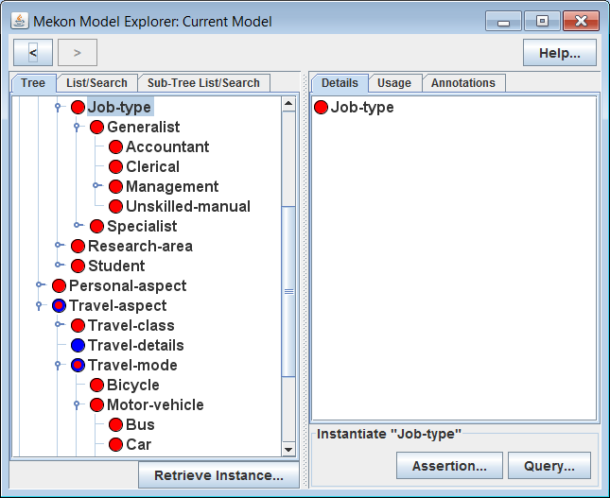
Actions:
Expand CFrame trees under both “Job-Type” and “Travel-Mode”
Explanation:
Note that the contents of both trees are derived mainly from external sources only, with the only exception being “Travel-Mode” itself
This is indicative of what more realistic models look like – i.e. being mainly constituted by large externally-derived hierarchies (much larger than in the demo model), with only a relative handful of core concepts being represented in the OM
When a CFrame with only an external source is instantiated, the nature of the corresponding OM instantiation is dependent on the presence or otherwise of internally-sourced ancestors. So, for instance, “Bus” will be represented in the OM via the TravelMode class, whereas “Accountant”, having no internally sourced ancestors, will be represented via a default implementation of DObject

Slide 26
Creating + Storing Assertion Instantiations

Slide 27
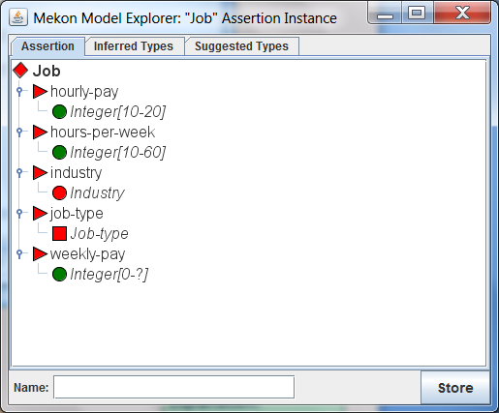
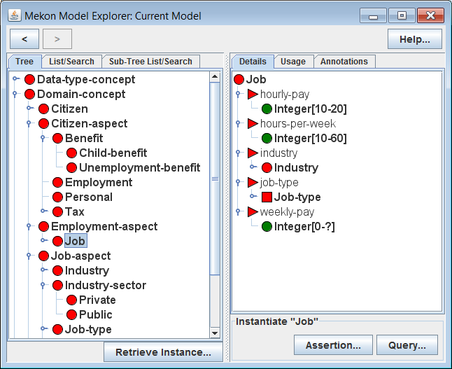
Actions:
Invoke ME with basic MEKON version of demo model
Select “Job” CFrame in LH panel
Click on “Assertion…” button in “Instantiate” area at bottom of RH panel
Explanation:
The new window that appears shows an IFrame that instantiates “Job”
This is an assertion, rather than query, instantiation (see next slide for details)
The instantiation is currently empty, in that no slot values have been set
The icons appearing underneath the ISlots represent the relevant value-types. The actual values, when set, will appear underneath the value-types
Icons Recap:
Note: ISlots are distinguished from CSlots by context alone
Reminder: See appendix at end of tutorial for Model Explorer invocation details
IFrame / External source
ISlot / External source

Slide 28
[MORE TO BE ADDED]

Slide 29
Creating + Executing Query Instantiations

Slide 30
[TO BE ADDED]

Slide 31
Appendix: Loading Demo Model into Model Explorer

Slide 32
Using Mekon project Build Facilities
Ensure that all relevant code/resources are checked out from Mekon project SVN
Invoke ANT build script:
Ensure that ANT is installed on your machine
Go to top-level folder of check-out
Type:
ant hobo-demo
Run Model Explorer:
Go to “build” directory, created by build script:
Invoke relevant script:
mekon-demo.bat/sh
hobo-demo.bat/sh

Slide 33
Using Your Own Build Facilities
Ensure that:
All relevant code/resources are checked out from Mekon project SVN
All code from ALL sub-projects is built
All code from “demo” folder is built
The “demo/resource” folder (or preferably a copy of it) is on your runtime class-path
Invoke main method on class for relevant version of Model Explorer:
...mekon.gui.MekonModelExplorer
...hobo.gui.HoboModelExplorer

